Slide 1
Discussion on the reviewers comments
26/02/2026

Slide 2
Out-of-Fold (OOF) Predictions - With Swelling Ratio
Rank | R² | MSE | MAE | Base Estimators | Key Features
1 | 0.383 | 436.24 | 15.423 | 50 | Lignin + PTHF + Ratio + Co-polyol + Isocyanate + Tin(II) octoate + Swelling Ratio
2 | 0.361 | 452.03 | 15.476 | 50 | Lignin + PTHF + Ratio + Co-polyol + Swelling Ratio
3 | 0.380 | 437.96 | 15.478 | 50 | Lignin + PTHF + Ratio + Co-polyol + Isocyanate + Isocyanate type + Tin(II) octoate + Swelling Ratio
4 | 0.353 | 458.24 | 15.498 | 1000 | Lignin + PTHF + Ratio + Co-polyol + Swelling Ratio
5 | 0.354 | 457.09 | 15.508 | 700 | Lignin + PTHF + Ratio + Co-polyol + Swelling Ratio
Top 5 Performing Models
R² Range: 0.35 - 0.38
MSE Range: 436.24 - 458.24
MAE Range: 15.42 - 15.51

Slide 3
Out-of-Fold (OOF) Predictions - Without Swelling Ratio
Rank | R² | MSE | MAE | Base Estimators | Key Features
1 | 0.337 | 468.17 | 15.714 | 700 | Lignin + PTHF + Ratio + Co-polyol + Isocyanate type
2 | 0.328 | 473.75 | 15.772 | 1000 | Lignin + PTHF + Ratio + Co-polyol + Isocyanate type
3 | 0.328 | 473.62 | 15.783 | 900 | Lignin + PTHF + Ratio + Co-polyol + Isocyanate type
4 | 0.328 | 473.73 | 15.799 | 800 | Lignin + PTHF + Ratio + Co-polyol + Isocyanate type
5 | 0.346 | 462.01 | 15.818 | 1000 | Lignin + PTHF + Ratio + Co-polyol + Isocyanate + Tin(II) octoate
Top 5 Performing Models
R² Range: 0.33 - 0.35
MSE Range: 462.01 - 473.75
MAE Range: 15.71 - 15.82

Slide 4
Stratified Train/Test/Validation Split
Rank | R² (Test) | R² (Val) | MSE (Test) | MSE (Val) | MAE (Test) | MAE (Val) | Base Est. | Key Features
1 | 0.55 | 0.49 | 338.37 | 391.95 | 15.17 | 13.41 | 10 | Lignin + PTHF + Ratio + Co-polyol + Isocyanate
2 | 0.20 | 0.46 | 595.12 | 417.46 | 17.77 | 13.54 | 10 | Lignin + PTHF + Ratio + Isocyanate
3 | 0.61 | 0.49 | 292.55 | 392.19 | 14.26 | 13.55 | 100 | Lignin + PTHF + Ratio + Co-polyol + Isocyanate
4 | 0.63 | 0.43 | 273.85 | 439.07 | 10.99 | 14.06 | 100 | Lignin + PTHF + Ratio + Co-polyol + Isocyanate type
5 | 0.67 | 0.43 | 245.82 | 439.48 | 10.21 | 14.08 | 500 | Lignin + PTHF + Ratio + Co-polyol + Isocyanate type
Top 5 Models
Best Test R²: 0.67 (Rank 5)
Best Test MSE: 245.82 (Rank 5)
Most Efficient: Rank 1 (R²=0.55 with only 10 estimators)

Slide 5
Key Insights
Approach | R² Range | Strengths | Concerns
OOF | 0.33-0.38 | Conservative, consistent, better generalization | Lower predictive power
Stratified | 0.43-0.67 | Higher accuracy, better predictions | Test/validation gap suggests overfitting risk
Validation Strategy Comparison
Optimal Configuration
For Maximum Accuracy:
Stratified Rank 5: R²=0.67, MSE=245.82, 500 estimators
For Efficiency:
Stratified Rank 1: R²=0.55, MSE=338.37, 10 estimators (50× faster)

Slide 6
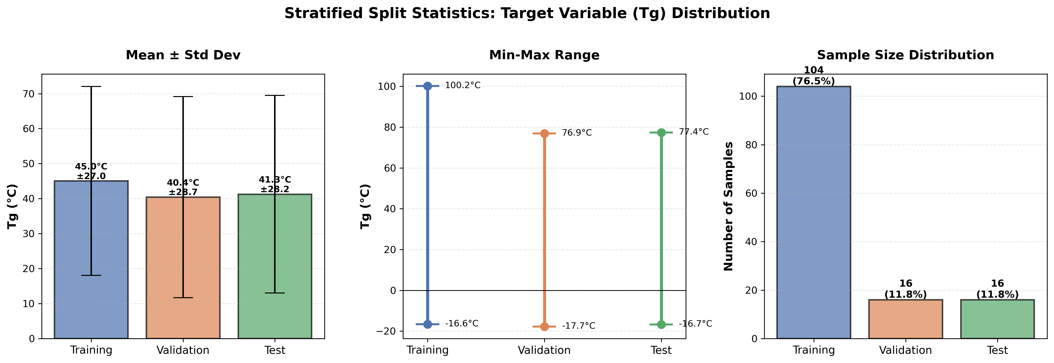
Stratified Sampling Statistics

Slide 7
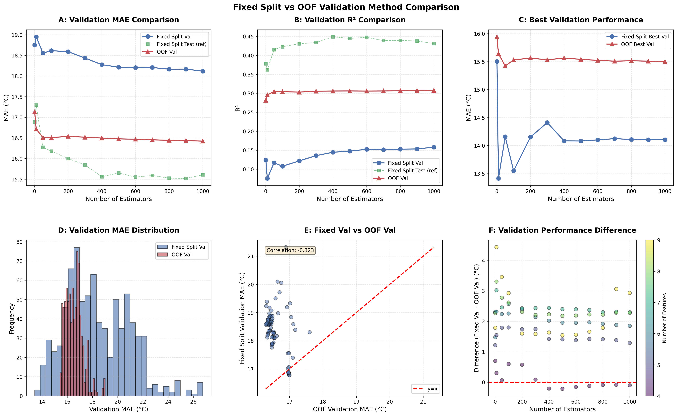
Comparison between OOF and Stratified Split
Notes:
1. PLOT 1: Validation MAE Comparison by N_Estimators
This IS calculating AVERAGES by n_estimators!
What this means:
- n_estimators=10: Average of 63 models = 18.951°C
- n_estimators=100: Average of 63 models = 18.615°C
- n_estimators=500: Average of 63 models = 18.215°C
2. PLOT 2: Validation R² Comparison by N_Estimators
This IS calculating AVERAGES by n_estimators!
3. PLOT 3: Best Validation Performance Comparison
This shows the BEST (minimum) MAE for each n_estimators
4. PLOT 4: Validation Performance Distribution Comparison
This shows ALL individual validation MAE values (no averaging)
5. SUMMARY:
- Plots 1 & 2: Use AVERAGES by n_estimators
- Plot 3: Uses BEST values by n_estimators
- Plot 4: Uses ALL individual values (no averaging)
- The table output shows individual model values (no averaging)

